Slide 1
Predict whether the cancer is benign or malignant
Wonjun Lee, Intelligence & Manufacturing Convergence Laboratory, ETRI, Daejun, Republic of Korea

Slide 2
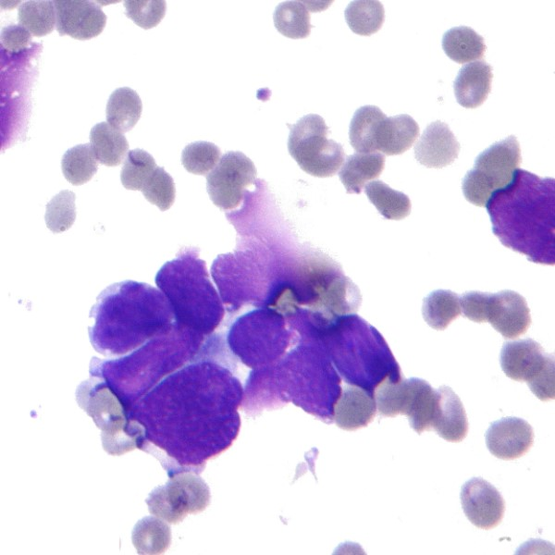
Motivation
Breast cancer is a fatal disease in which abnormal tissue in the breast continues to grow or metastasize to other organs.
Evaluating the possibility of deterioration by looking at the shape of the tumor is the most important point in preventing cancer.

Slide 3
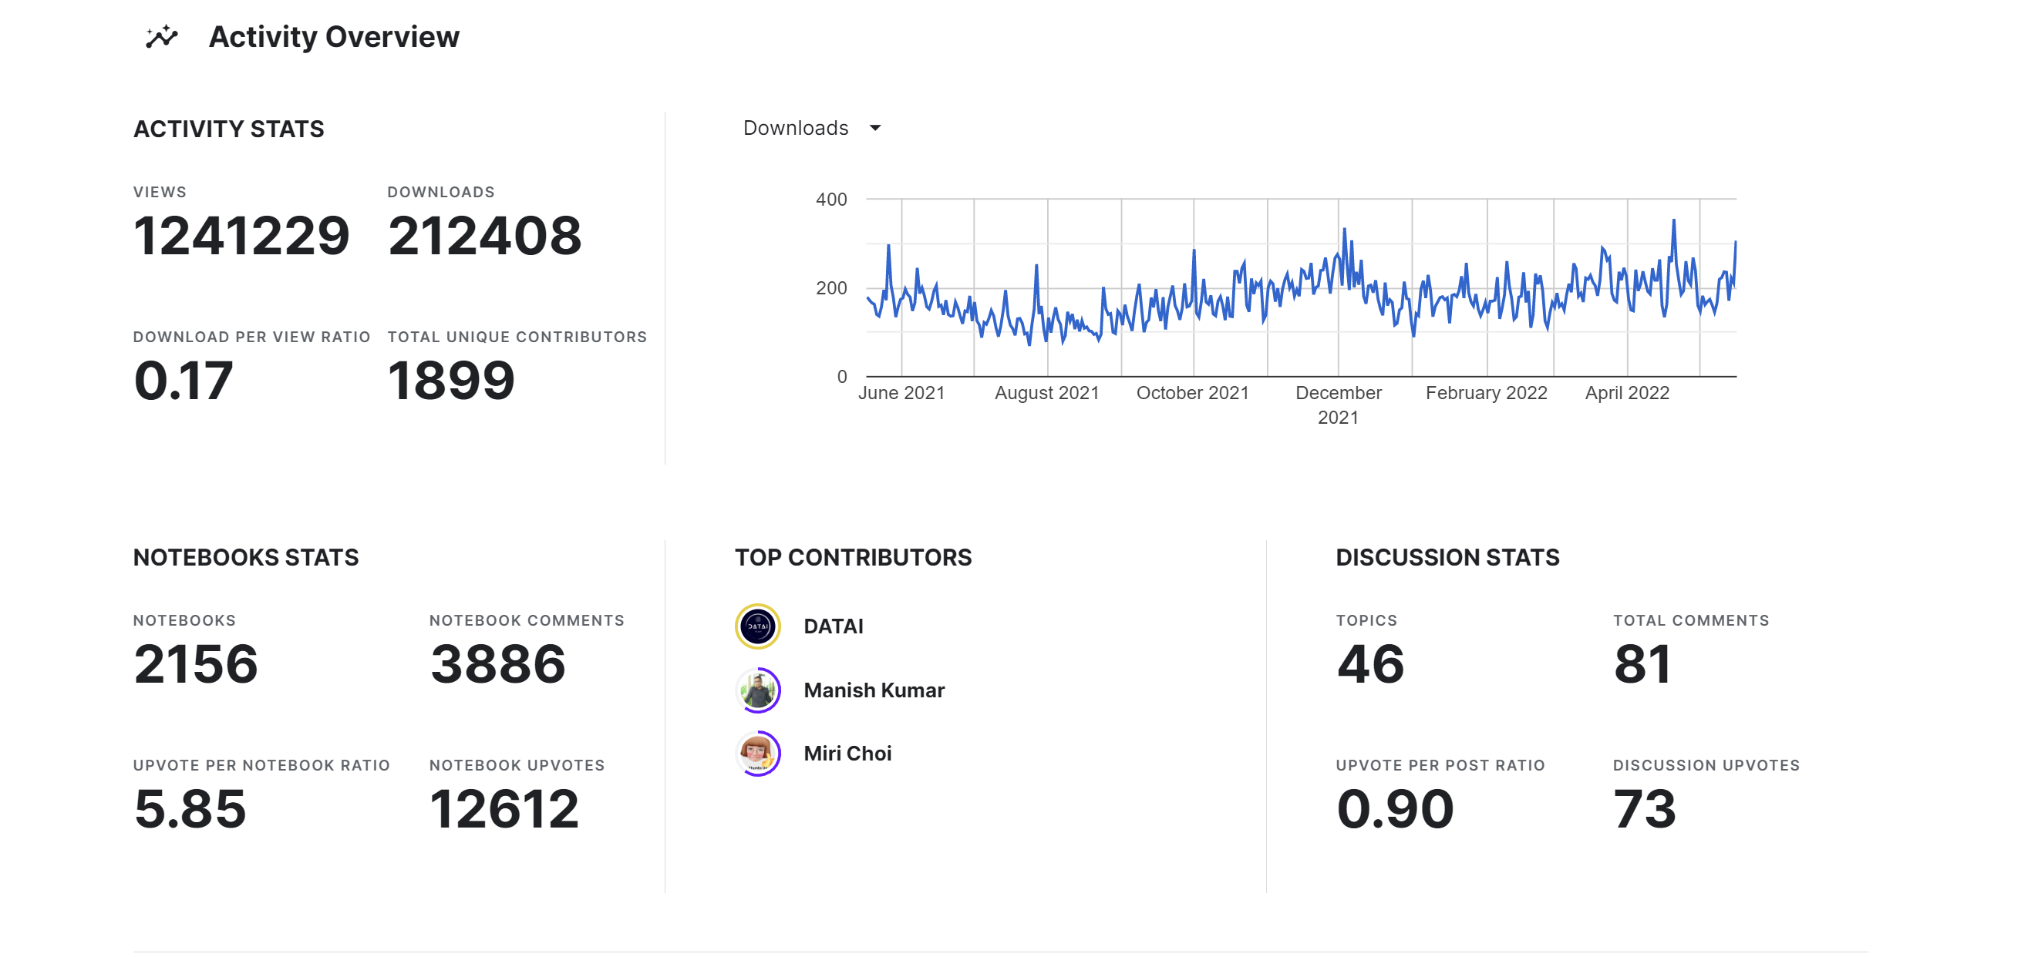
Motivation
Since the formation of the Wisconsin Breast Cancer Dataset,
many people have been working on increasing accuracy.

Slide 4
Experimental methods and objectives
First, data preprocessing through EDA and various ML techniques are applied
In addition, deep learning techniques are applied
Improving accuracy over existing results is the final goal of this paper

